Slide 1
Case Study 1
You have been hired by the road transport authority of a city in India to help them solve the rising traffic issues. You will have to make a presentation to define the following
- reason for the increase in traffic
- propose short term and long term solutions.
The solutions need to be supported with a business case on feasibility & return on investment.Consider any of the following cities - Mumbai, Bangalore, Pune or New Delhi which are the cities with the worst traffic problem.
Table of Contents: Slide No
Introduction:....……..…………………………... 1
Problem Overview:……………………………... 2
Reasons……………………………………………….. 3
Short-term Solutions………………………….... 3
Long term solutions…………………………….... 4
Feasibility and comparison…………………... 5
Name: Shubham Ekapure
Roll No. : 18ME10060
Email/Contact: shubhamekapure@gmail.com, +91-9637612309

Slide 2
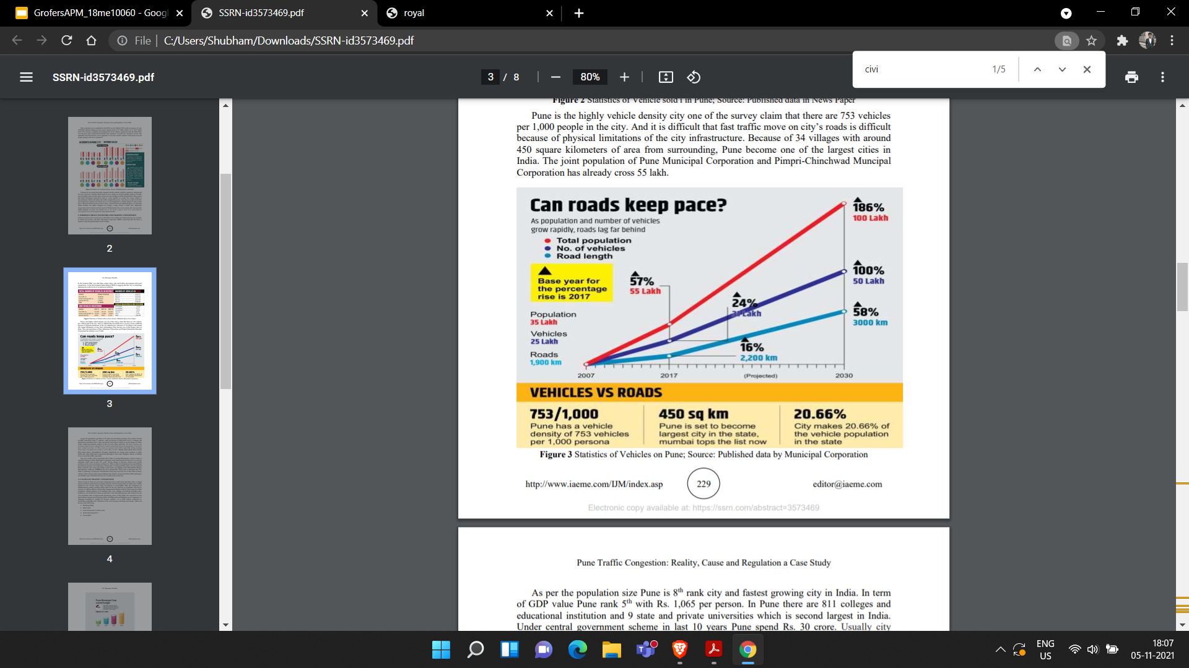
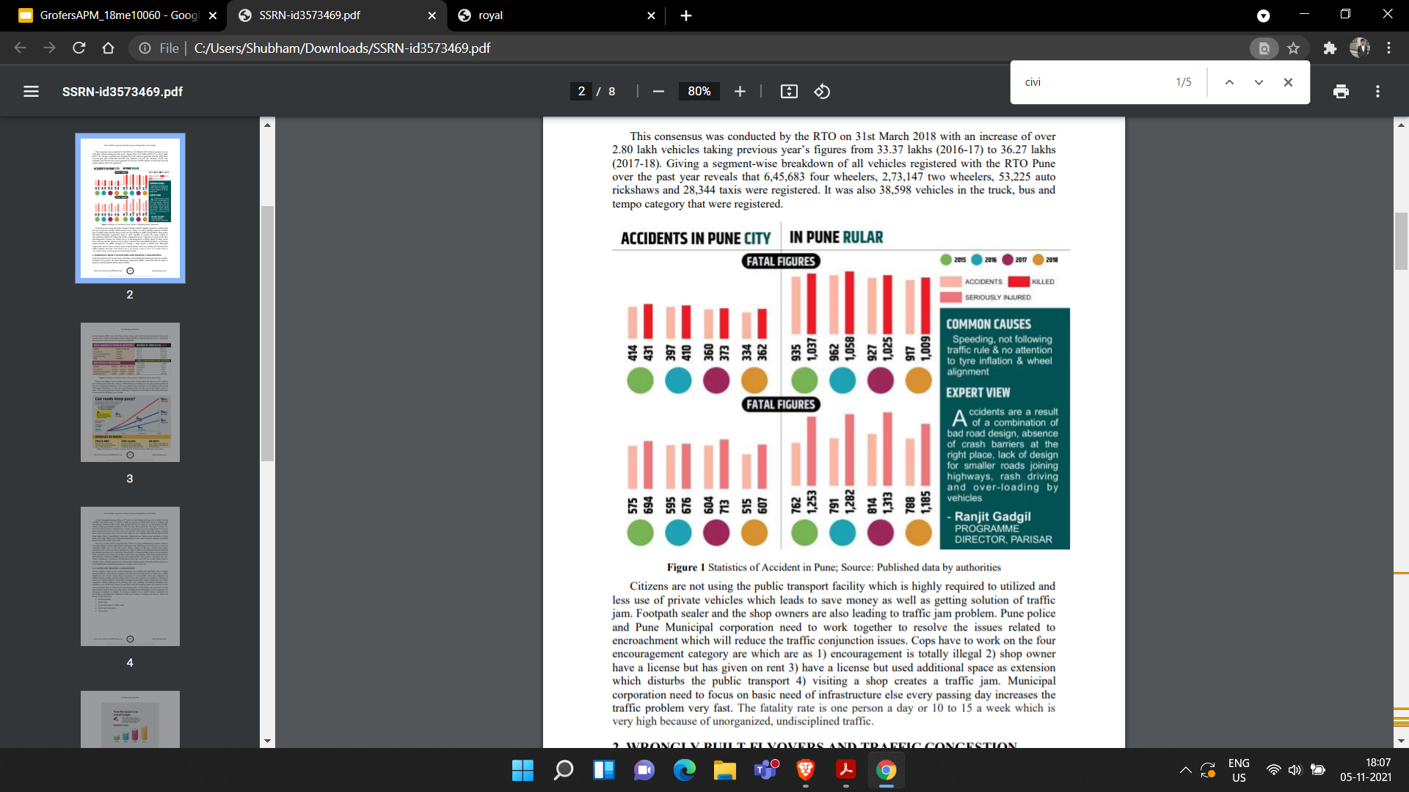
Problem : Impactful and feasible solutions for rising traffic issues in Pune
Problem Overview:
It is the first Indian city in which vehicle population is more than human.
During the peak morning and evening hours, traffic situation gets worse in Peth areas owing to the schools and colleges and narrow roads and lanes.
IT offices located in Hinjewadi and Kharadi and Industrial Zone at Bhosari very often see evening congestion.
The city has built 50+ flyovers, which have only shifted the bottlenecks from road intersections to here.
The annual road budget has grown at 25% from 2016 to 2020 still no solutions address the major bottlenecks.
Impact of solving the problem:
Reduction in congestion mainly in busy parts of Pune.
Shrinking the concentration of pollutants like PM10 and PM2.5 from the air.
Revenue opportunities from the development of existing public transports like metro, buses.
Safer transits and reduction in the number of fatal road related accidents.
Economic loss and increase in logistic cost incurred from jams can be reduced.
City | Pollutant | Sunday | Monday | Wednesday
Pune | PM10 | 124 | 106 | 106
 | PM2.5 | 66 | 59 | 59
Delhi | PM10 | 359 | 356 | 357
 | PM2.5 | 225 | 223 | 216
Mumbai | PM10 | 149 | 148 | 148
 | PM2.5 | 110 | 110 | 108
Note: Moderate level of PM2.5 is 12-35 ug/m³ and PM10 is 55 ug/m³. Safe levels are below 12 for both. References for the data present above: Pune Traffic Congestion. PMPML:

Slide 3
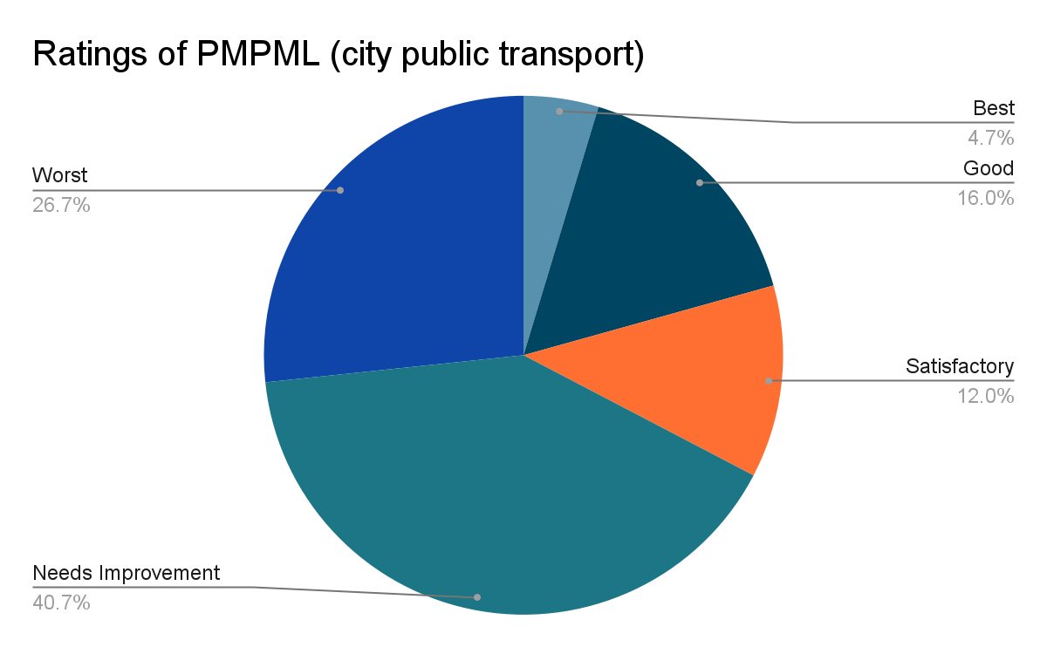
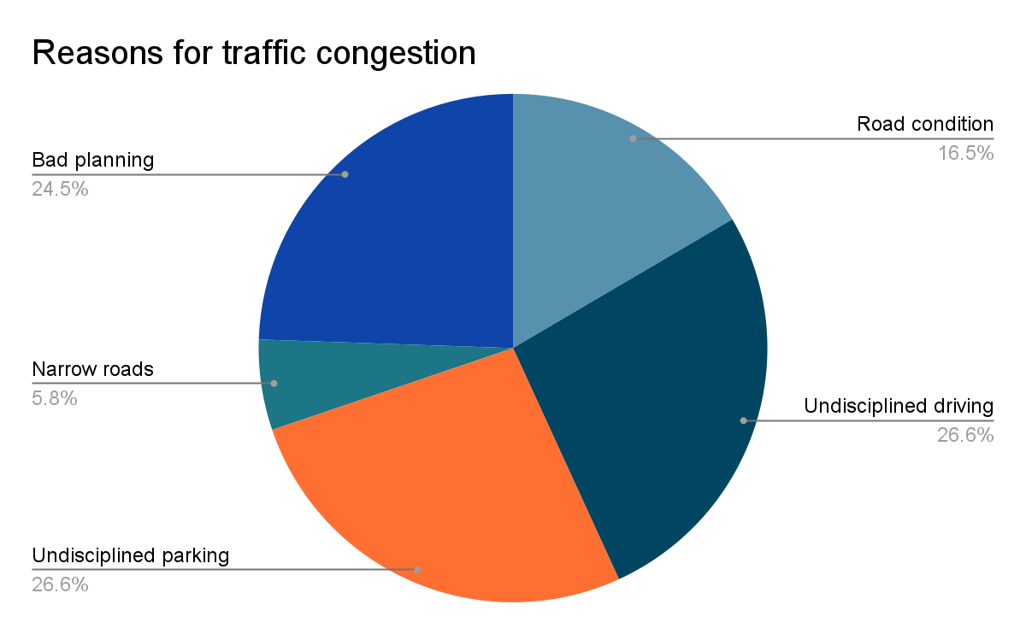
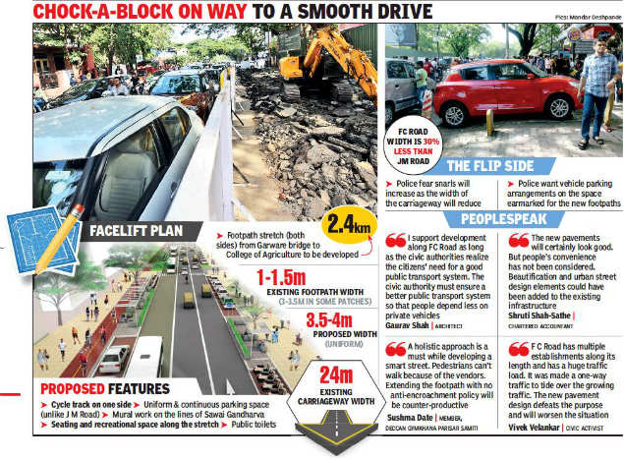
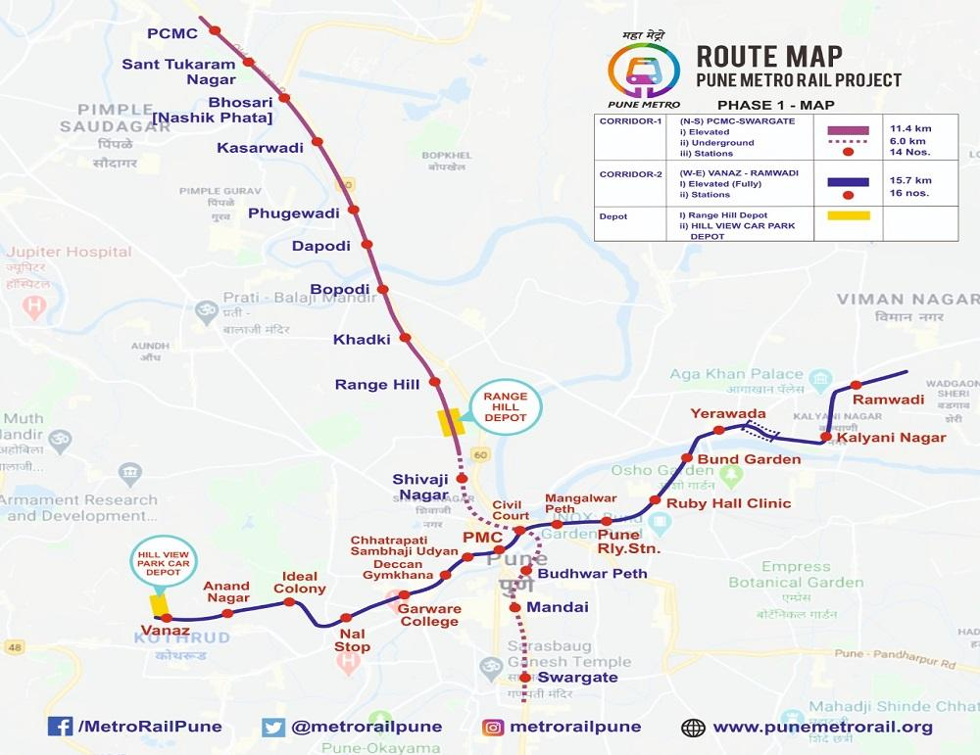
Reasons for traffic congestions and problems in Pune
Short-term solutions for Pune traffic issues
While a lot of factors make the traffic problem in Pune unique compared to other cities. Consider some results based on the following research paper Road Traffic Congestion: A case study of Pune. A great length of roads in Pune is narrow and is made narrower by footpath parking, halting etc. Heavy vehicle transit goes through the main city making the problem worse. Occasionally the traffic signals are out of sync creating chaos. Let’s look at some statistical data for other reasons:
While Pune still isn’t close to Delhi or Mumbai in terms of the scale of the problem but no action will lead to the same situation down the line. While solutions like flyovers, more and wider roads exist, I won’t discuss them as once the population and vehicle fleet of the city grows, these solutions start failing. A few short term strategies are discussed below which require minimum investments in terms of capital and time:
Increase traffic police in areas with high seasonal congestion.
Optimize traffic-light management across the city.
Pune needs to extend parking zones, illegal parking on roads will be minimized and workplaces should have their own parking spaces.
Timing of diggings should be fixed and should be on a fast track so that the traffic does not get disrupted.
The heavy vehicles should use alternate routes and they should be penalized for entry into the main city without permission.
Pune metro has connected major IT areas with the main city very well but around 70% of people travel using cars and bikes as there aren’t many transport options from metro stations. It has the potential to ease the load from the existing public transport system irrespective of the busy times across the day. Solutions like road-widening and flyovers. yield temporary results. More vehicles bring back the city to square one.
Awareness about the benefits of public transport needs to increase. Its preference over private vehicles should increase over time. The same has to be done by promoting cycling and walking too.

Slide 4
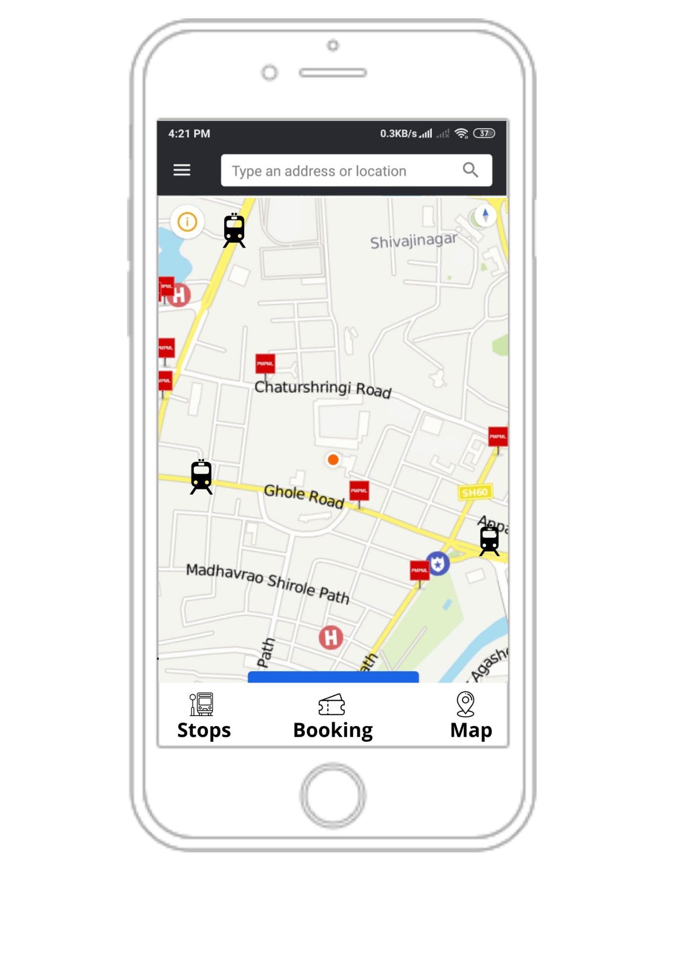
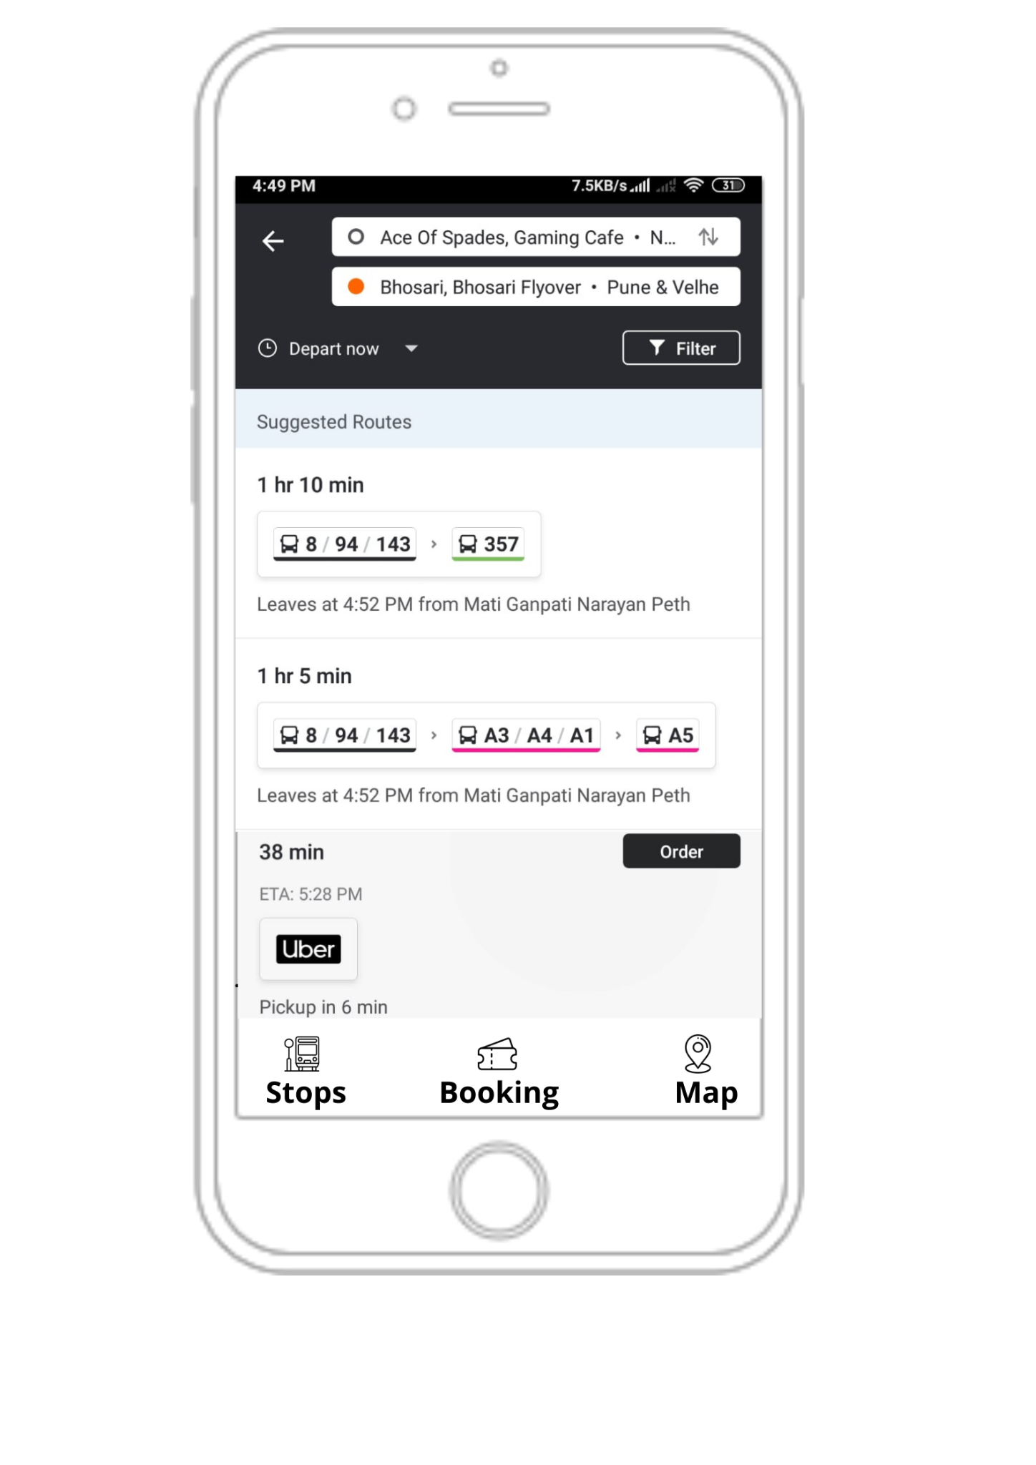
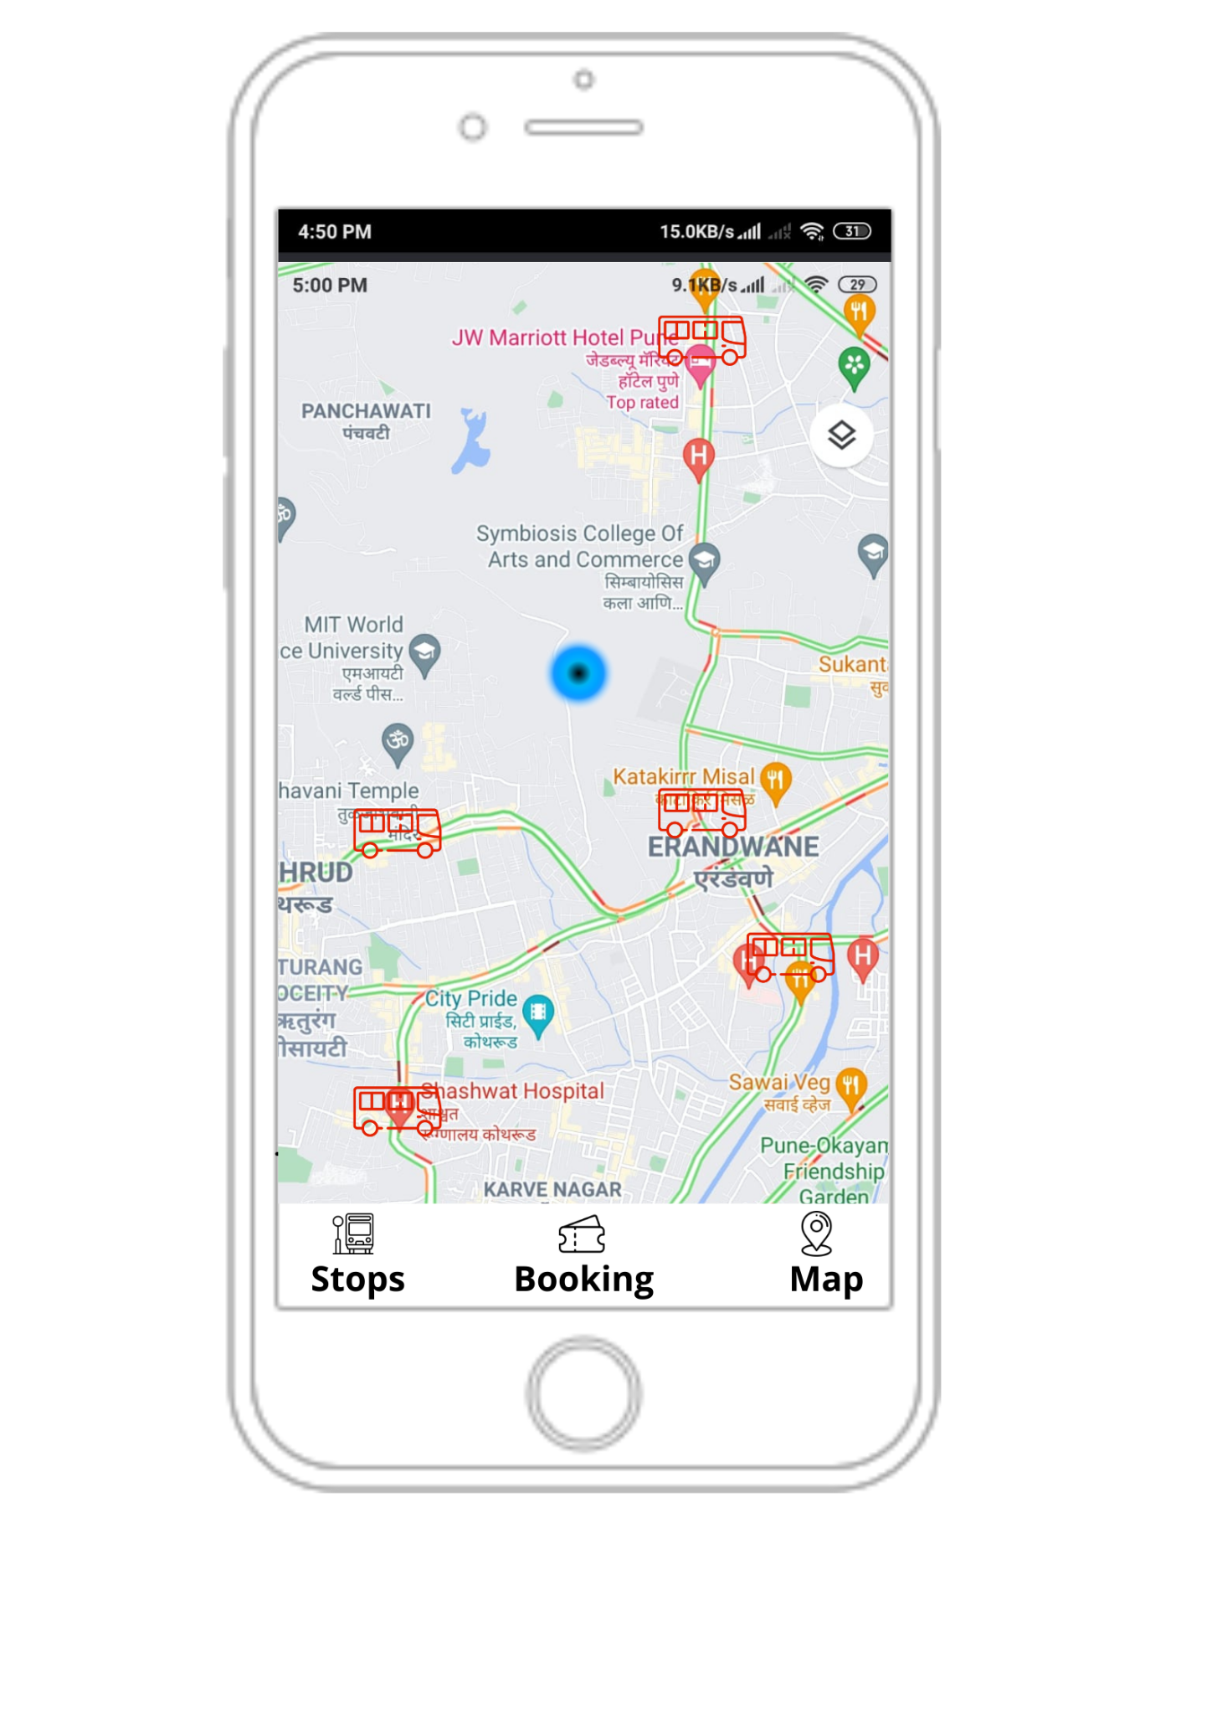
Long Term: Intelligent Transport System(ITS) solutions for PMPML
Overview:
For a growing city like Pune, it is good to look at least cost non-infrastructure solutions. One such long term solution is ITS integration across PMPML. To eliminate growing private fleet it is paramount to increase the use of public transportation. This city transportation service needs a lot of revamping to reduce user fatigue in travel. ITS provides a single solution for transport to schedule and monitor buses with the help of advance technologies such as GPS, Wi-Fi and GPRS.
Solution:
Integrate ITS to PMPML to provide a real-time view of the bus transportation network for scheduling, route and dispatch management. Data centres regulate traffic flow by navigating drivers. UI(app) for the public to utilize this information for the journey. Surveillance cameras for illegal haltings and parking at bus stops and taxi stations. Introducing a clean energy bus fleet in the city.
Impact:
For User:
Options for scheduling journey online and reduced fatigue in locating the nearest bus and its arrival time so they can coordinate it with metro travel for regular use like college or office.
Decreased time for initiating travel and reaching the destination.
For PMPML:
Operators can adjust traffic flow and reduce congestion based on real-time information.
Enable bus drivers to choose the best routes so as to avoid narrow lanes and busy roads.
Catch illegal parking, heavy vehicle transits from the city and major jams if any sooner.
Implementation:
Investments across the data centre will be needed. Additionally ITS systems in public transport, camera setup needs to be properly maintained as they are the lifelines of the solution. Developing the user application and onboarding may take at the earliest around 6 months.
PMPML App:
The wireframes address pain points of user to consider public transport. In Stops, a user can get location on nearest Bus stand and metro from him. Booking is for online booking, ITS data can be used for online booking across PMPML buses. This can be integrated with taxis and cabs and booked/sorted by departure time, custom departure time, fewest transfers. Map is an add-on for booking that gives position of buses with respect to our position..
The iron law of induced demand: more cars over time bring the city back to square one. References: Non-Infrastructure solutions, Reducing Traffic Congestion.

Slide 5
Comparison of the solutions based on feasibility:
Solutions | Short term solutions | Long term ITS solution
Benefits | All the solutions are cheap, low maintenance. They can solve 70% of existing traffic problems. | It makes the user journey by PMPML simpler. A robust solution to prevent congestion and jams. It doesn’t fail over time as the population grows.
Risks | It will need a lot of manual intervention. It won’t address the pollution problems. | The ITS setup will need regular maintenance. Technology will need skilled workers to handle it.
Cost of Implementation | ₹50 Lakhs (Traffic:installation + maintenance, extra police, traffic awareness) | ₹16 crores(Installing ITS, setting up a data centre, app development and overall maintenance)
Timescale | 6-8 months(max time for increasing parking space) | 2 years(Setup and integration will need max time)
Stakeholders | City Council and Traffic control and police. | Traffic control, data centre executives, ITS providers, people support staff
Returns | Generate around ₹4 lakhs in the economy. Minimize infrastructure costs. Lesser congestion peaks. | Increased revenue from PMPML and metro, reduced pollutant concentration, faster traffic movements.
Robust solution is much better for longer time.
Detailed cost estimation
It is interesting to note that short term solution though cheap can’t provide good return on environment, public transport but still can solve the problem.
Road widening, flyover and road construction take nearly 2-4 years to complete. Both the proposed solutions complement well to such construction projects to prevent congestions for a much longer time.

